Slide 1
Audio to Sign Language Conversion
SWE3999 – TECHNICAL ANSWERS FOR REAL WORLD PROBLEMS
J – COMPONENT → REVIEW 2 AND REVIEW 3

Slide 2
TEAM MEMBERS
S.NO | NAME | REGISTER NUMBER | FACULTY NAME
1. | UDAYAKIRAN N S | 18MIS1040 | Dr. Asnath Victy Phamila Y
2. | VADAPALLI AKARSH | 18MIS1006 | Dr. Asnath Victy Phamila Y
3. | SAI CHARAN B | 18MIS1099 | Dr. Asnath Victy Phamila Y
4. | SATHVIK M | 18MIS1039 | Dr. Geetha S
5. | GOLLA NOBUL KUMAR | 18MIS1027 | Dr. Nithyadarisini P S

Slide 3
INTRODUCTION
Sign language is a visual language that deaf and dumb people use as their first language. Sign language, as opposed to acoustically transmitted sound patterns, employs body language and physical communication to convey a person's thoughts.
It can be used by someone who has difficulty speaking, or by someone who can hear but cannot talk, and it can also be used by non-hearing handicapped individuals to communicate with hearing disabled people.
Access to a sign language is critical for a deaf person's social, emotional, and linguistic development.
Deaf and hard of hearing people from India use Indian Sign Language to communicate by making signs with different parts of their bodies.
ISL signs are divided into three categories: one handed, two handed, and non-manual signs. One handed and two handed signs are sometimes known as manual signs since the signer makes the signs using his or her hands to transmit information. Non-manual signals are produced by altering body position and facial expressions.

Slide 4
OBJECTIVES
With the introduction of new technologies such as web applications, machine learning, and natural language processing, our research will try to bridge the gap between these Deaf individuals and regular people.
The primary goal of this project is to provide an interface that takes audio/voice input and transforms it to matching Sign Language for Deaf individuals.
It is accomplished by integrating hand forms, orientation, and movement of the hands, arms, or body at the same time.
The interface operates in two stages, first converting audio to text using voice to text API (python modules or Google API), and then representing the text using Parse Trees and using Natural Language Processing semantics (NLTK particularly) for lexical analysis of Sign Language Grammar.
The work is based on the norms of ISL (Indian Sign Language) and refers to the grammar standards of ISL.

Slide 5
MOTIVATION (SOCIETAL IMPACT)
There are roughly 5.07 million persons in India who are deaf. More than a third of them are under the age of 20, with the remainder falling between the ages of 20 and 60. Because these people are typically unable to talk correctly, they interact with others using sign language.
Because sign languages lack a well-defined structure or grammar, these signs have no or very little acceptance outside of the limited community of these differently abled persons.
Communication is difficult for hearing-impaired persons in public areas such as train stations, bus stops, banks, and hospitals because a hearing person may not comprehend the sign language used by the deaf person to communicate.
Furthermore, a hearing person cannot transmit any message to a deaf person since he or she may not be familiar with sign language.

Slide 6
MOTIVATION (SOCIETAL IMPACT)
Language translation is required to facilitate communication between the deaf and non-deaf communities.
Communication is difficult for the deaf people in common areas such as railways, banks, and hospitals due to their inability.
To assist them communicate more effectively with the rest of the world, a system that converts text to Indian Sign Language and vice versa is required.
These systems will improve the community's standard of living. Sign languages have not received as much attention as spoken languages, and there is still much to learn about them.
It is the notion of individuals showing up at a predetermined place, either individually or as a group, for a previously arranged event.

Slide 7
LITERATURE SURVEY
S.NO | TITLE | AUTHOR | JOURNEL | YEAR PUBLISHED | DESCRIPTION
1. | Study of Sign Language Translation using Gesture Recognition | Neha Poddar, Shrushti Rao, Shruti Sawant, Vrushali Somavanshi | IJARCCE | 2015 | This project is a small step towards helping a physically challenged people and lot more can be done to make the product more sophisticated, user friendly & efficient. Using more memory and powerful microprocessor, more languages can be covered. This project can be modified to make it compatible with mobile phones. We can increase the range of product by using more powerful trans-receiver module.

Slide 8
LITERATURE SURVEY
SNO | TITLE | AUTHOR | JOURNEL | YEAR PUBLISHED | DESCRIPTION
2. | Generating Indian Sign Language Text Using English/Hindi Text | Pawan Kumar, Savita Khatri | IJRRA | 2016 | In this paper, they have compared the existing models for the conversion of plain English/Hindi Text into the Indian Sign Language Text. Most of the systems which have been developed so far are meant to work only for a single domain. A unified system is needed for the deaf-mute community to help them interact with the normal people in their day to day lives.

Slide 9
LITERATUR SURVEY
SNO | TITLE | AUTHOR | JOURNEL | YEAR PUBLISHED | DESCRIPTION
3. | Audio to Sign Language Translation for Deaf People | Ankita Harkude, Sarika Namade, Shefali Patil, Anita Morey | IJEIT | 2020 | In this paper, they have implemented translation from input audio to sign language. It translate each and every letter in the audio message and it displays each sign language letter. But it is not efficient in future purpose

Slide 10
PROBLEM STATEMENT
Audio to Sign Language Recognition System which would convert standard sign language audio to text then to sign language.
This system is developed for the deaf and dumb.
This system can be used in various places like Railway Stations, Online classes and so on.

Slide 11
SOFTWARE AND HARDWARE REQUIREMENTS
HARDWARE REQUIREMENTS:
Minimum requirements: 4 GB of RAM and dual core processor.
Recommended requirements: 8 GB of RAM and quad core processor.
Microphone, Speaker, Internet Connectivity
SOFTWARE REQUIREMENTS:
Programming language: Python 2.7 or above
Libraries Required: NLTK, Django
Programming IDE: Pycharm professional.

Slide 12
PROPOSED SYSTEM
Getting Audio as input
Converting Audio to Text using WebKit Speech Recognition API.
Dependency parser for analysing grammatical structure of the sentence and establishing relationship between words.
ISL Generation of input sentence using ISL grammar rules.
Generation of sign language with signing Avatar.

Slide 13
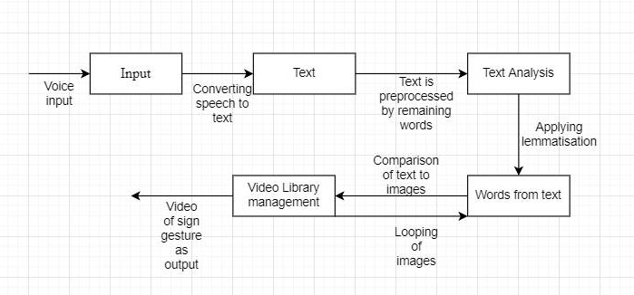
ARCHITECTURE DIAGRAM

Slide 14
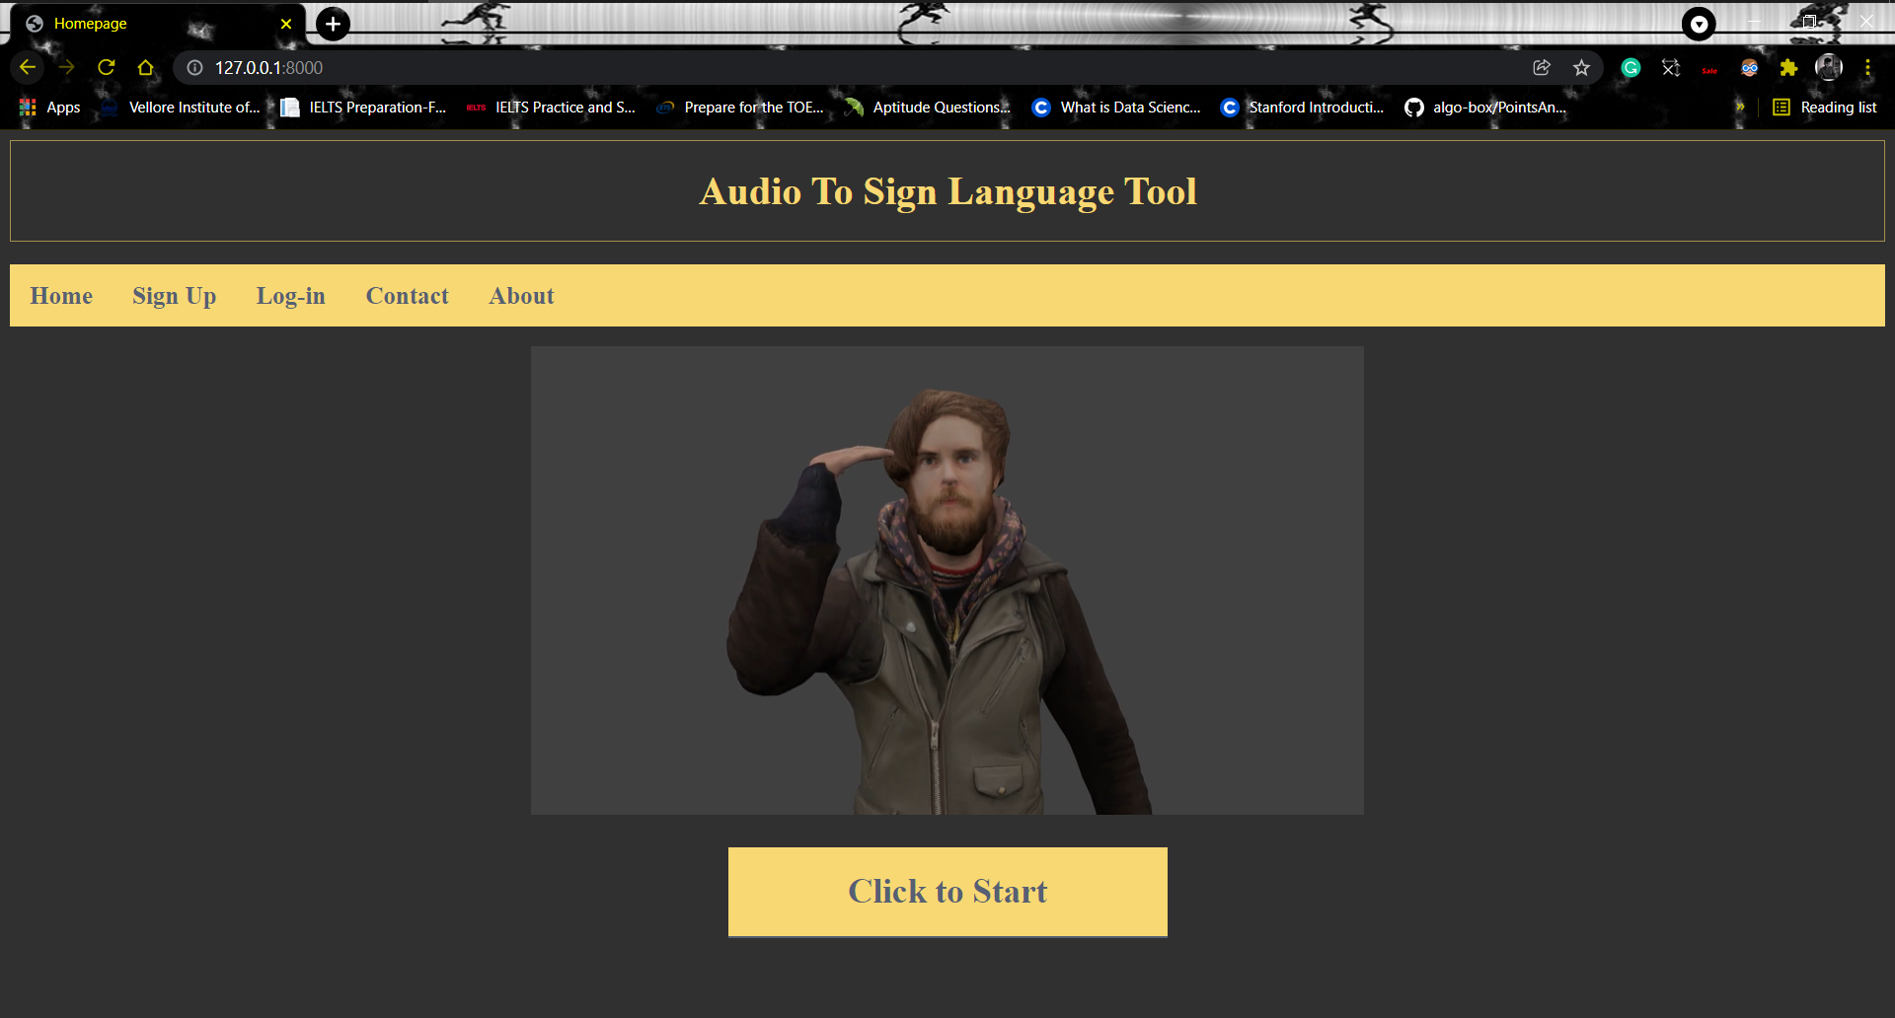
OUTPUT SNAPSHOTS → Home Page

Slide 15
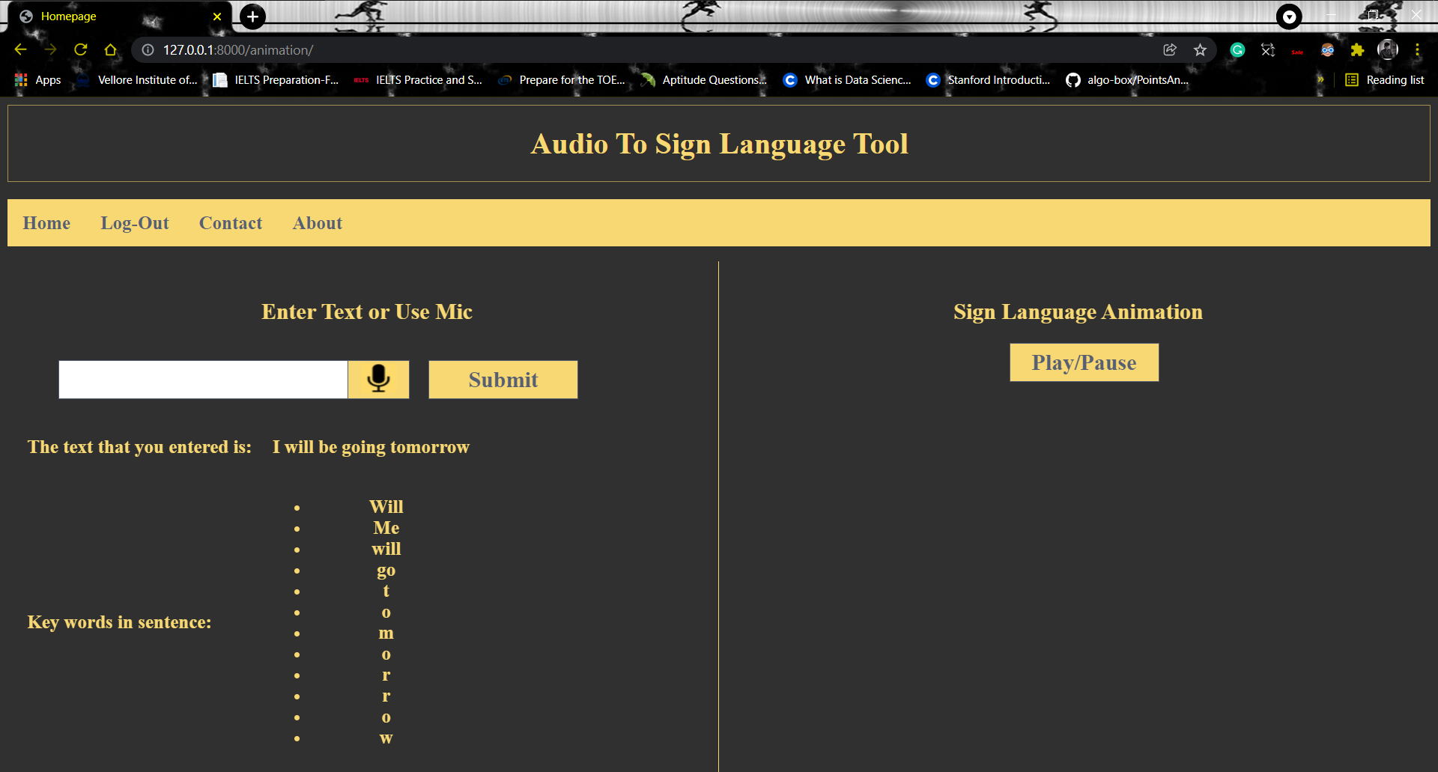
OUTPUT SNAPSHOT → Conversion WebPage

Slide 16
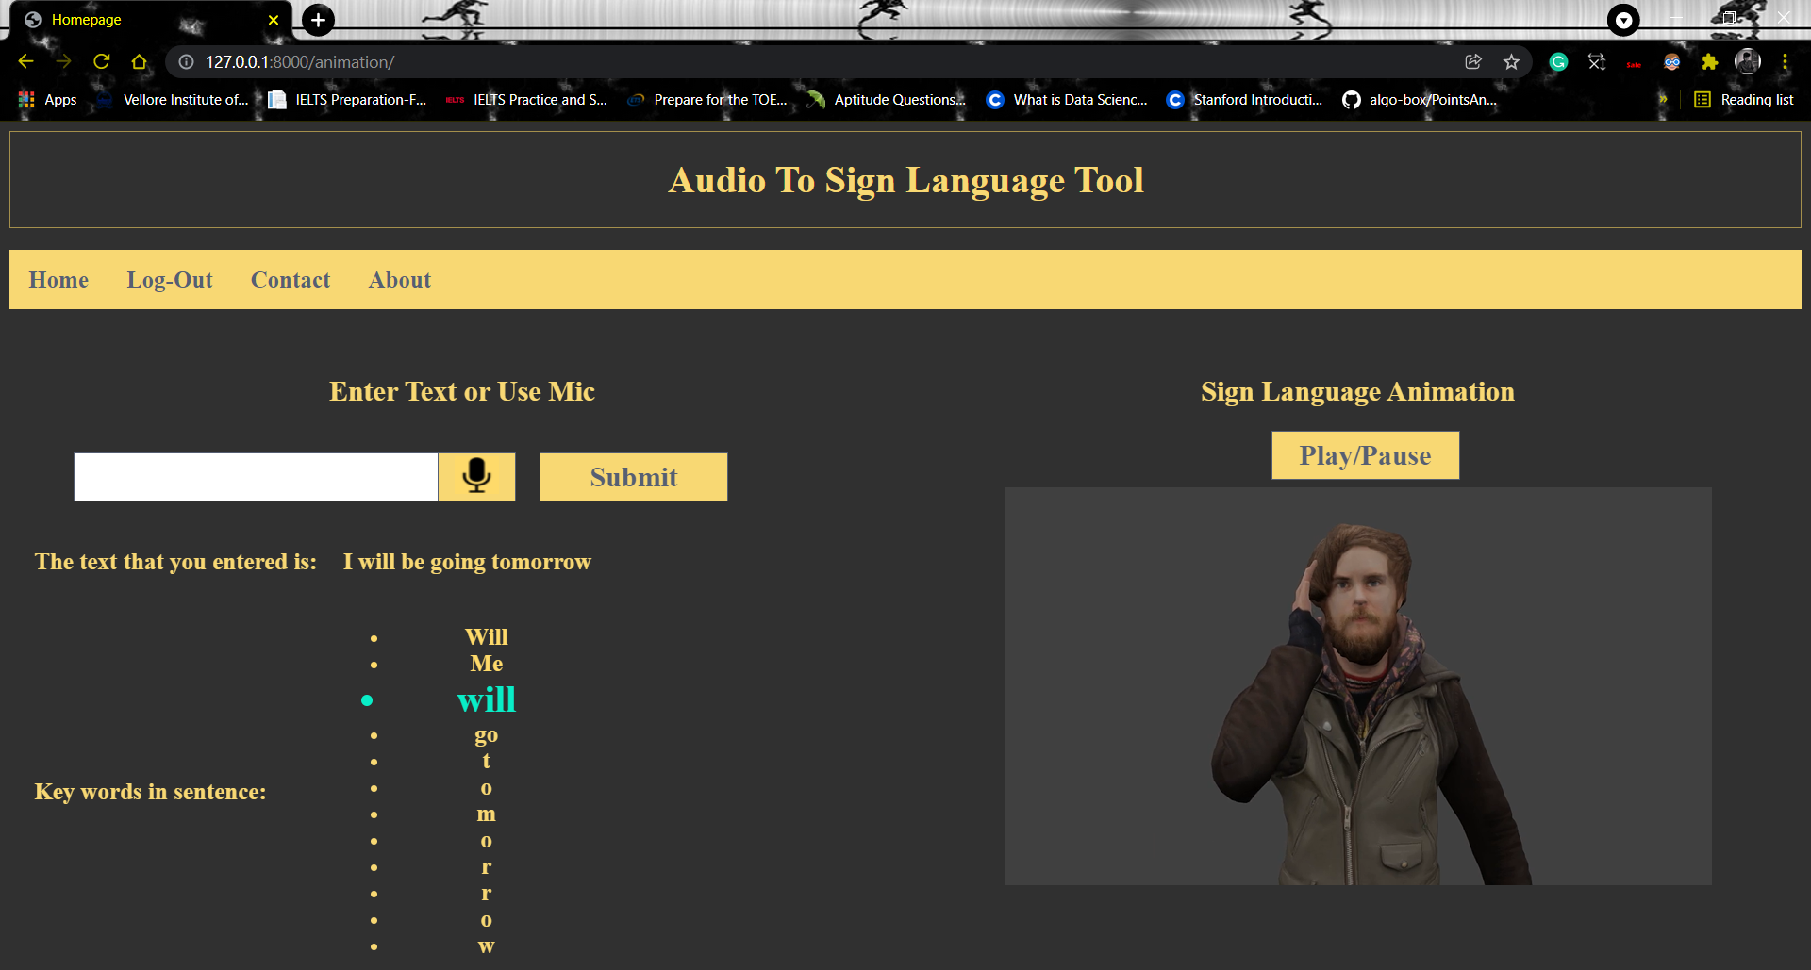
OUTPUT SNAPSHOT → Sign Language Result

Slide 17
REFERENCES
Generating Indian Sign Language Text Using English/Hindi Text - https://www.ijrra.net/ICCUT2016/ICCUT2016_13.pdf
Study of Sign Language Translation using Gesture Recognition - https://ijarcce.com/wp-content/uploads/2015/03/IJARCCE4M.pdf
Audio to Sign Language Translation for Deaf People - https://www.ijeit.com/Vol%209/Issue%2010/IJEIT1412202004_05.pdf
https://www.analyticssteps.com/blogs/what-stemming-and-lemmatization-nlp
https://link.springer.com/chapter/10.1007/978-981-16-2406-3_64
https://dl.acm.org/doi/abs/10.1145/1031171.1031285

Slide 18


